Slide 1
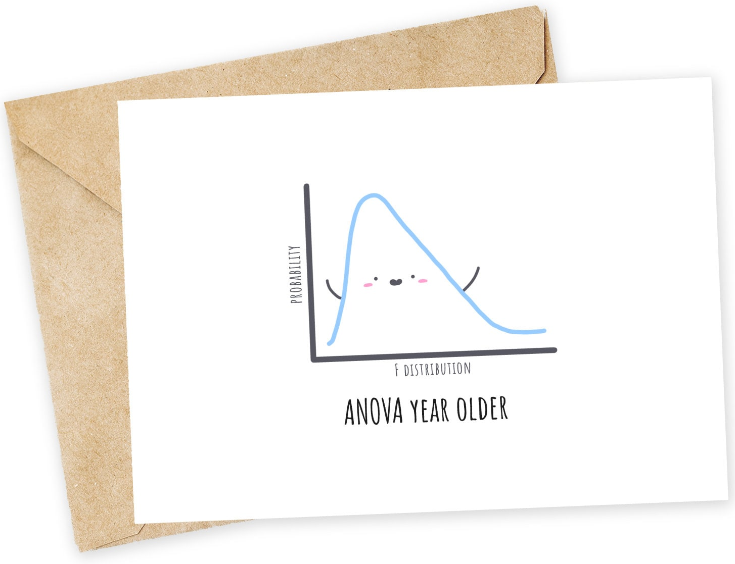
Comparing Three or More Groups
ENTMLGY 6702 Entomological Techniques and Data Analysis

Slide 2
Learning objectives
Understand why, when, and how to conduct an ANOVA
Summarize experimental components using linear models

Slide 3
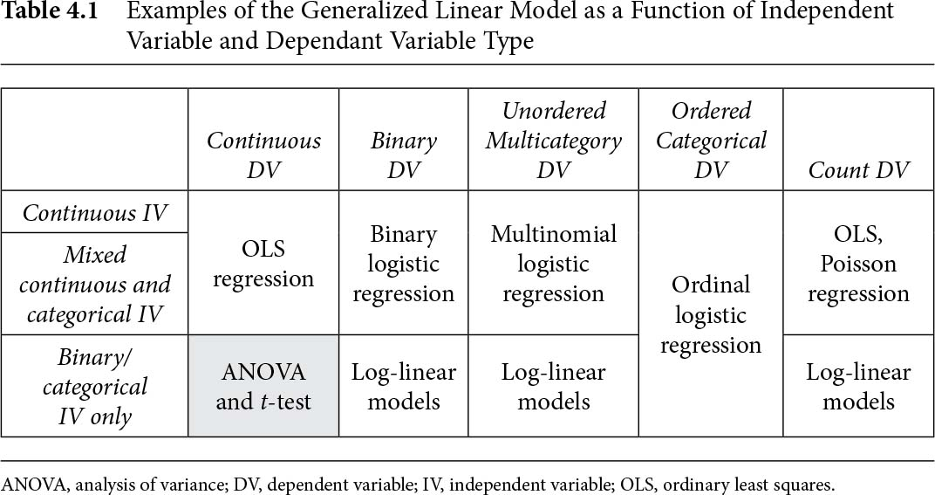
Which analytical framework should I use?
Responses
Predictors
Chapter 4: Simple Linear Models With Continuous Dependent Variables: Simple ANOVA Analyses
In: Regression & Linear Modeling: Best Practices and Modern Methods

Slide 4
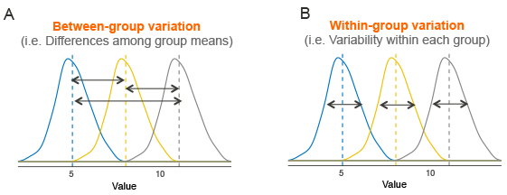
ANalysis Of VAriance (ANOVA)

Slide 5
ANalysis Of VAriance (ANOVA)
Source | df | SS | MS | F
Treatment | k-1 | formula | SSTrt1÷dfTrt1 | MS_{trt}/MS_{err}
Error | N-k | formula | SSErr÷dfErr
Total | N-1 | formula | -
Note that:
MS = mean square = SS ÷ df for each component.
We get F-statistics from this table (F-ratio)!
F_{trt df, err df} = MS_{trt} / MS_{err}
From the F-statistic and degrees of freedom, we can calculate a p-value and evaluate our null hypothesis.

Slide 6
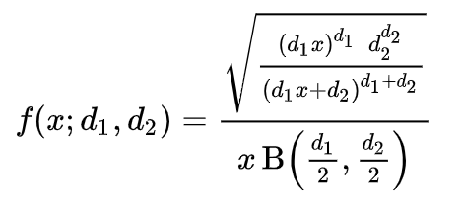
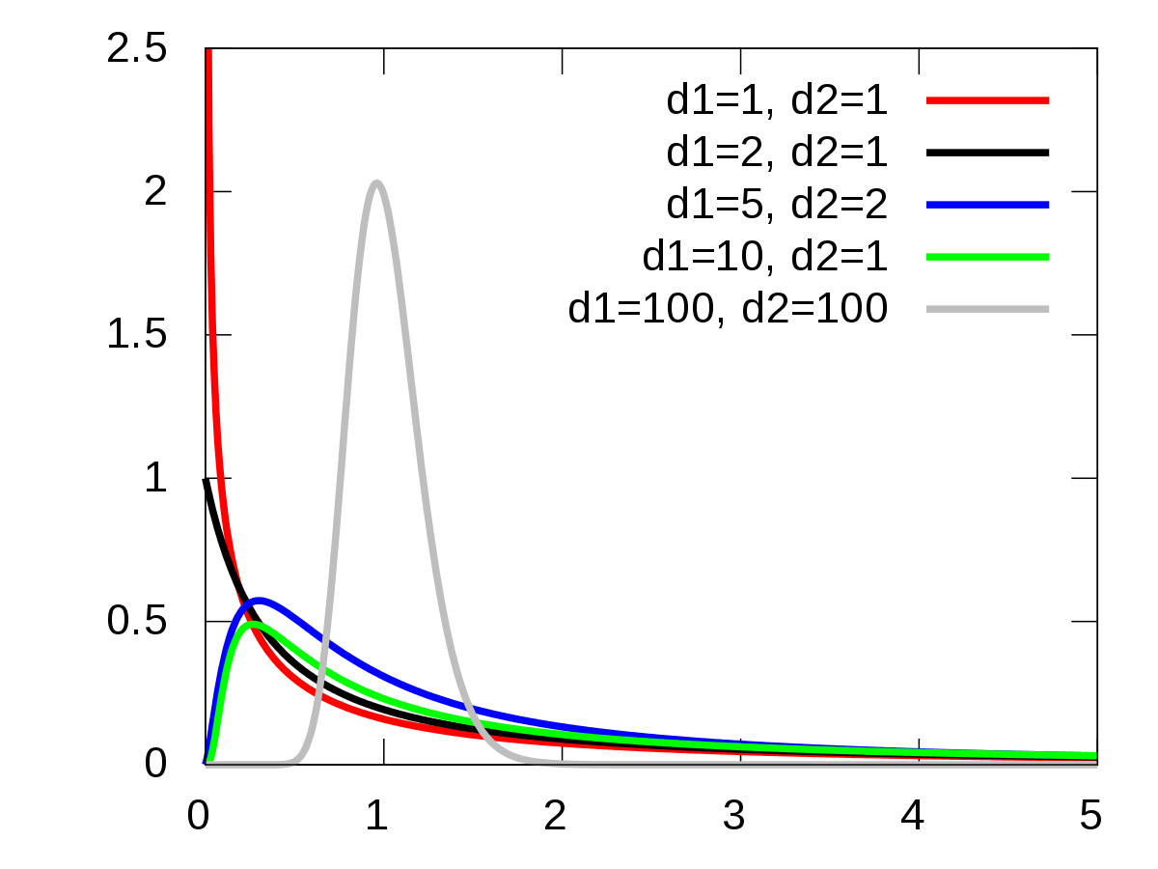
F distribution

Slide 7
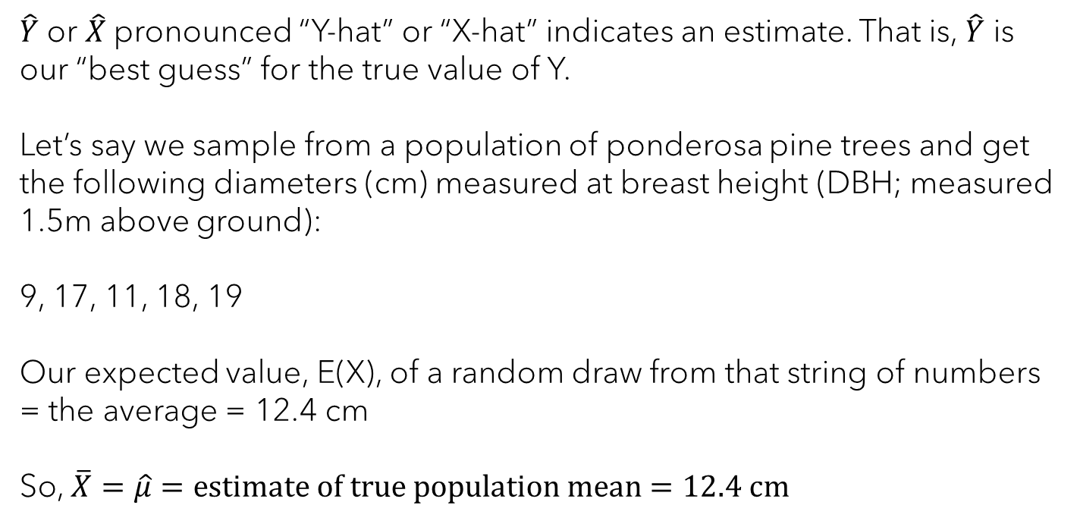
Definitions
$\hat{Y}$ or $\hat{X}$pronounced “Y-hat” or “X-hat” indicates an estimate. That is, $\hat{Y}$ is our “best guess” for the true value of Y.
Let’s say we sample from a population of ponderosa pine trees and get the following diameters (cm) measured at breast height (DBH; measured 1.5m above ground):
9, 17, 11, 18, 19
Our expected value, E(X), of a random draw from that string of numbers = the average = 12.4 cm
So, $\overline{X}=\hat{μ}=estimate of true population mean=12.4 cm$

Slide 8
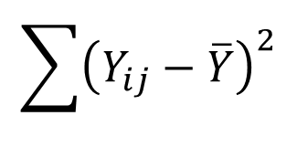

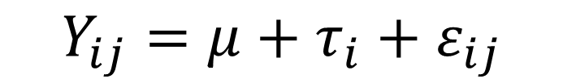

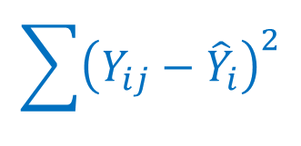

Linear model
$$Y_{ij}=μ+τ_{i}+ε_{ij}$$
${\hat{Y}}_{i}=$ µ + τ_{i}
${\hat{Y}}_{i}=$ µ + τ_{i}
$$\sum{{\left(Y_{ij}−\overline{Y}\right)}^{2}}$$
$$\sum{{\left({\hat{Y}}_{i}−\overline{Y}\right)}^{2}}$$
$$\sum{{\left(Y_{ij}−{\hat{Y}}_{i}\right)}^{2}}$$
SS Total
SS Treatment
SS Error
(ε_{ij})²

Slide 9
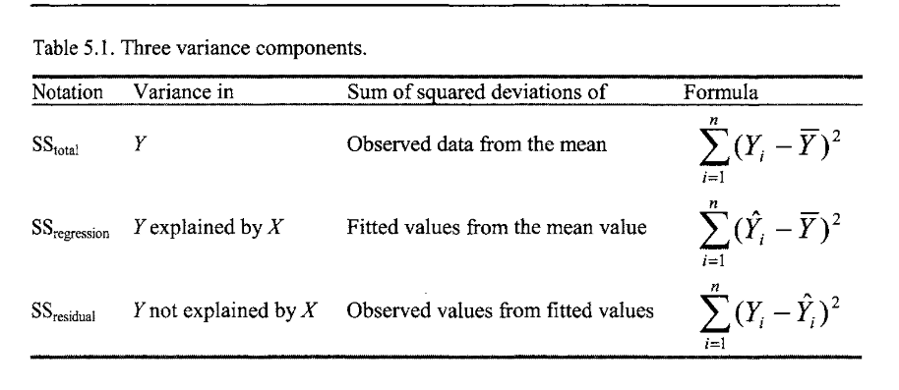
Linear model
$$Y_{ij}=μ+τ_{i}+ε_{ij}$$

Slide 10

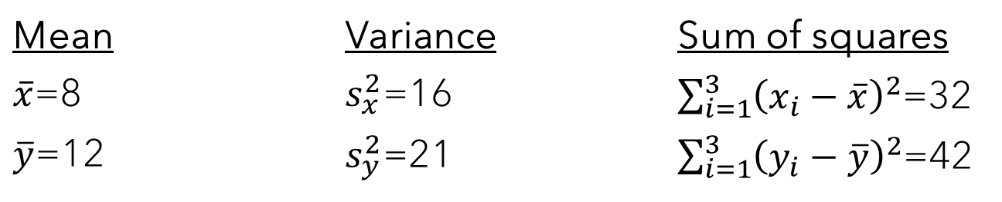
Sum of squares (SS) activity (don’t submit)
Consider two independent samples:
X: 4, 12, 8
Y: 17, 8, 11
The summary statistics are:
Mean | Variance | Sum of squares
$\overline{x}$=8 | $s_{x}^{2}$=16 | $\sum_{i=1}^{3}{{\left(x_{i}−\overline{x}\right)}^{2}}$=32
$\overline{y}$=12 | $s_{y}^{2}$=21 | $\sum_{i=1}^{3}{{\left(y_{i}−\overline{y}\right)}^{2}}$=42
$$\sum_{i=1}^{n}{{\left(X_{i}−\overline{X}\right)}^{2}}$$

Slide 11
Sum of squares (SS): Definition
A main goal of experimental design, particularly blocking, is to partition the variance into components.
Key definition:
SS Total = SS Treatment + SS Error
So, we can attribute all the variation (total sum of squares, SST) in our variable of interest (response variable) to explanatory variables (sum of squares of treatments, SST) and unexplained/leftover variation (sum of squares of error, SSE).
Sometimes written:
Total (TSS) = Explained (ESS) + Residual (RSS)

Slide 12

Total Sum of Squares
First, calculate mean:
$$\frac{\left(4+12+8\right)+(17+8+11)}{6}=10$$
And SS Total is:
(4−10)² + (12−10)² + (8−10)² + (17−10)² + (8−10)² + (11−10) ² = 98
on total df = n-1 = 5
where n = total number of observations

Slide 13
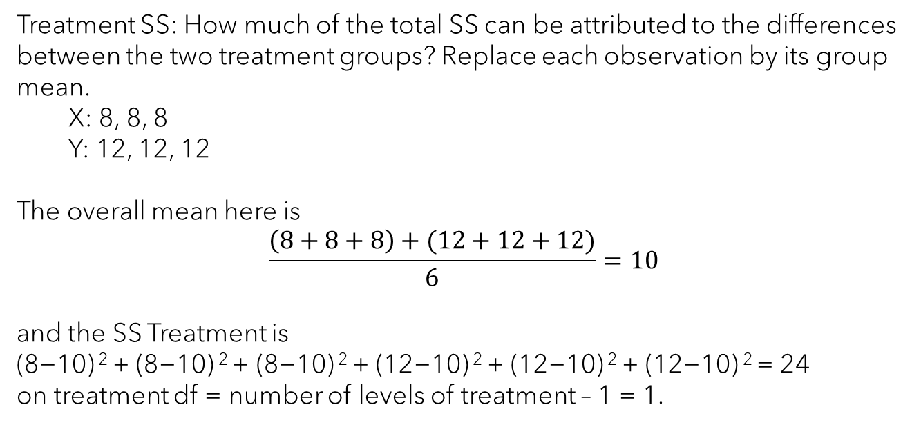
Treatment Sum of Squares
Treatment SS: How much of the total SS can be attributed to the differences between the two treatment groups? Replace each observation by its group mean.
X: 8, 8, 8
Y: 12, 12, 12
The overall mean here is
$$\frac{\left(8+8+8\right)+(12+12+12)}{6}=10$$
and the SS Treatment is
(8−10) ² + (8−10) ² + (8−10) ² + (12−10) ² + (12−10) ² + (12−10) ² = 24
on treatment df = number of levels of treatment – 1 = 1.

Slide 14
Error Sum of Squares
Error SS: How much of the total SS can be attributed to the
differences within each treatment group? The SS Error is
(4−8) ² + (12−8) ² + (8−8) ² + (17−12) ² + (8−12) ² + (11−12) ² = 74
on error df = df Total – df Treatment = 5 – 1 = 4

Slide 15
ANalysis Of VAriance (ANOVA)
Source | df | SS | MS
Treatment | 1 | 24 | 24
Error | 4 | 74 | 18.5
Total | 5 | 98 | -
Note that:
MS = mean square = SS ÷ df for each component.
We get F-statistics from this table (F-ratio)!
F_{1,4}=24/18.5 = 1.30
From the F-statistic and degrees of freedom, we can calculate a p-value and evaluate our null hypothesis.

Slide 16
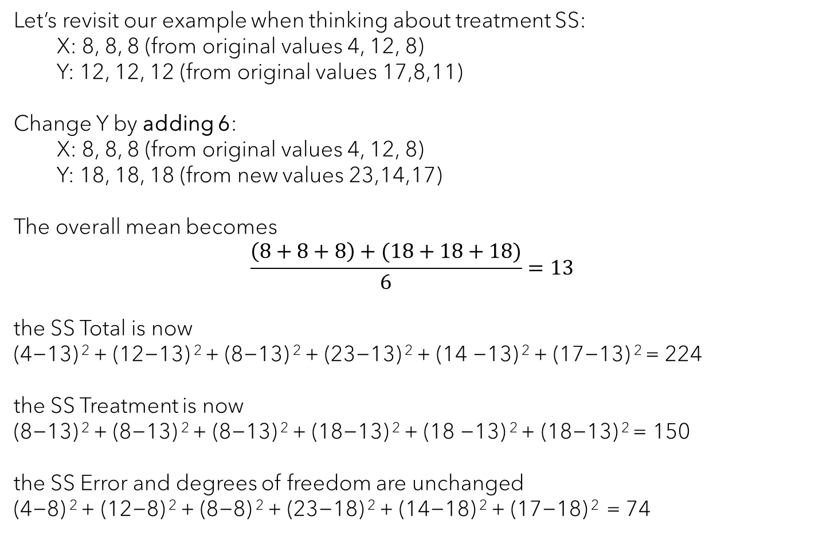
Treatment Sum of Squares
Let’s revisit our example when thinking about treatment SS:
X: 8, 8, 8 (from original values 4, 12, 8)
Y: 12, 12, 12 (from original values 17,8,11)
Change Y by adding 6:
X: 8, 8, 8 (from original values 4, 12, 8)
Y: 18, 18, 18 (from new values 23,14,17)
The overall mean becomes
$$\frac{\left(8+8+8\right)+(18+18+18)}{6}=13$$
the SS Total is now
(4−13) ² + (12−13) ² + (8−13) ² + (23−13) ² + (14 −13) ² + (17−13) ² = 224
the SS Treatment is now
(8−13) ² + (8−13) ² + (8−13) ² + (18−13) ² + (18 −13) ² + (18−13) ² = 150
the SS Error and degrees of freedom are unchanged
(4−8) ² + (12−8) ² + (8−8) ² + (23−18) ² + (14−18) ² + (17−18) ² = 74

Slide 17
ANOVA
Source | df | SS | MS
Treatment | 1 | 24 to 150 | 24 to 150
Error | 4 | 74 | 18.5
Total | 5 | 98 to 224 | -
New F-ratio:
F_{1,4}=150/18.5 = 8.11
The variance among our treatments went up (i.e., the treatment means are very different), so the numerator in our F-ratio went up.

Slide 18
One-way ANOVA table
Source | df | SS | MS | F
Treatment | k-1 | formula | SSTrt1÷dfTrt1 | MS_{trt}/MS_{err}
Error | N-k | formula | SSErr÷dfErr
Total | N-1 | formula | -

Slide 19
Two-way ANOVA tables
Table 1
Source | df | SS | MS | F
Treatment A | k-1 | formula | SSTrt1/dfTrt1 | MS_{A}/MS_{e}
Treatment B | b-1 | formula | SSTrt2/dfTrt2 | MS_{B}/MS_{e}
Error | N-dfTrt1-dfTrt2-1 | formula | SSErr/dfErr
Total | N-1 | formula | -
Table 2
Source | Df | SS | MS | F
Treatment A | k-1 | formula | SSTrt1÷dfTrt1 | MS_{A}/MS_{e}
Treatment B | b-1 | formula | SSTrt2÷dfTrt2 | MS_{B}/MS_{e}
A×B Interaction | (k-1)(b-1) | formula | SSInt÷dfInt | MS_{A×B}/MS_{e}
Error | N-kb | formula | SSErr÷dfErr
Total | N-1 | formula | -

Slide 20
ANOVA in R
Well…maybe a bit of background on how R conducts an ANOVA first….

Slide 21
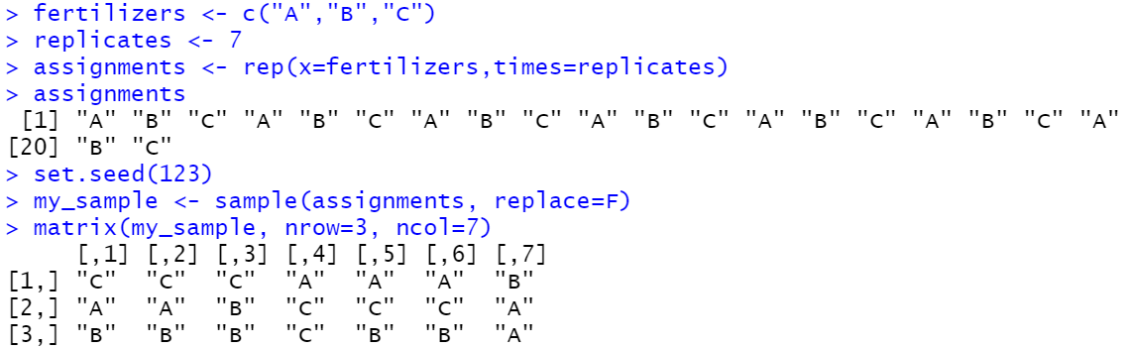

Completely randomized design
Sampling universe (e.g., farm)
A
B
C
single plant

Slide 22
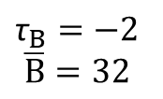
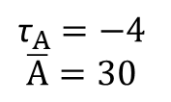
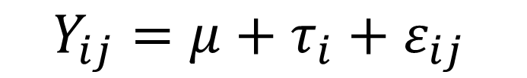

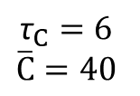
Linear model
$$Y_{ij}=μ+τ_{i}+ε_{ij}$$
Response
Predictors
µ
$$\text{µ}=34$$
τ_{A}
τ_{B}
τ_{C}
25
32
32
24
26
30
36
36
42
38
40
44
28
33
36
29
35
32
33
44
39
$${\text{τ}}_{A}=−4$$
$$\overline{A}=30$$
$${\text{τ}}_{B}=−2$$
$$\overline{B}=32$$
$${\text{τ}}_{C}=6$$
$$\overline{C}=40$$
Y_{C1}
Units = biomass of plants in grams

Slide 23
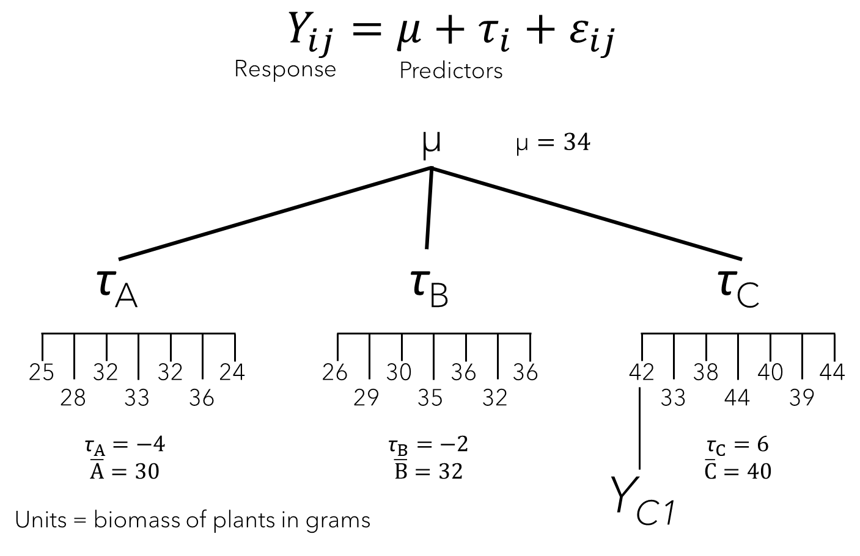
Activity
On your scratch paper, organize these data into a spreadsheet ready for analysis in R (the design/layout of a spreadsheet is fine - you don’t need to write out the whole thing). How many rows and columns in Excel would you have?

Slide 24
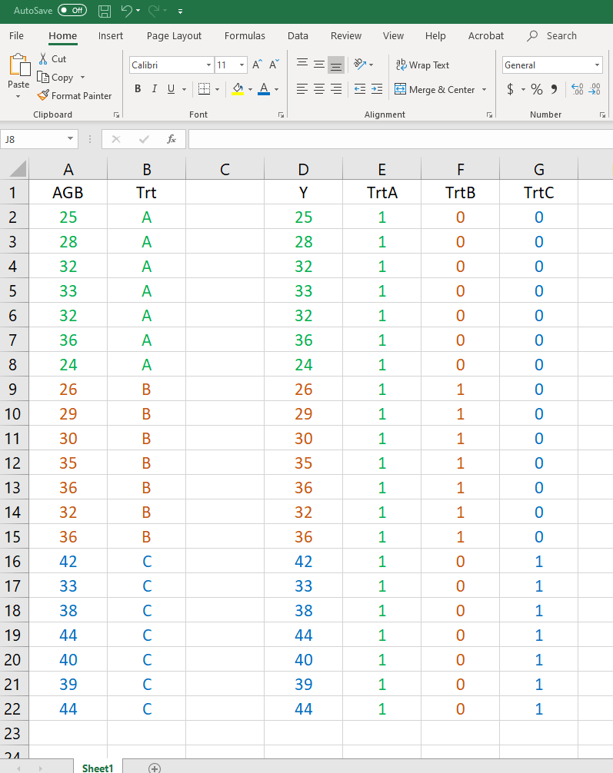
Activity

Slide 25
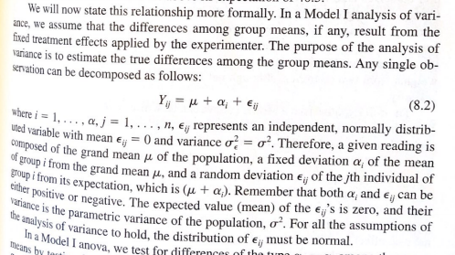
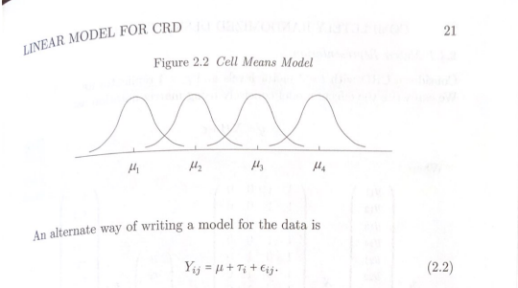

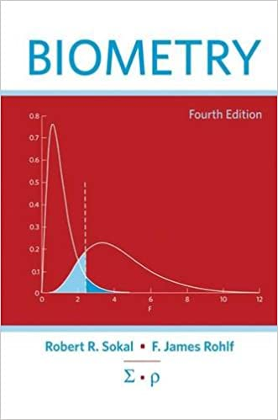
Linear model
$$Y_{ij}=μ+τ_{i}+ε_{ij}$$

Slide 26
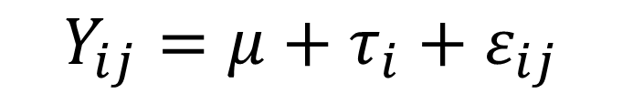
Linear model
$$Y_{ij}=μ+τ_{i}+ε_{ij}$$
ε_{C4}=4
Above ground biomass (g)
40
τ_{C} =6
34
µ
τ_{A} = -4
32
30
τ_{B} = -2
Trt A
Trt B
Trt C

Slide 27
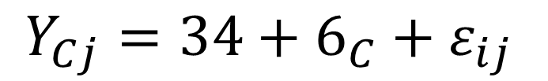
Linear model
$$Y_{Cj}=34+6_{C}+ε_{ij}$$
ε_{C4}=4
Above ground biomass (g)
40
τ_{C} =6
34
µ
τ_{A} = -4
32
30
τ_{B} = -2
Trt A
Trt B
Trt C

Slide 28

Linear model
$$Y_{ij}=μ+τ_{i}+ε_{ij}$$
$$Y_{ij}=β_{0}X_{μj}+β_{1}X_{Aj}+β_{2}X_{Bj}+β_{3}X_{Cj}+ε_{ij}$$
ε_{C4}=4
Above ground biomass (g)
40
τ_{C} =6
34
µ
τ_{A} = -4
32
30
τ_{B} = -2
Trt A
Trt B
Trt C

Slide 29




Linear model
$$Y_{ij}=μ+τ_{i}+ε_{ij}$$
$$Y_{ij}=β_{0}X_{μj}+β_{1}X_{Aj}+β_{2}X_{Bj}+β_{3}X_{Cj}+ε_{ij}$$
$β_{0}=$ 𝜇
$$β_{1}={\text{τ}}_{A}$$
$$β_{2}={\text{τ}}_{B}$$
$$β_{3}={\text{τ}}_{C}$$
ε_{C4}=4
Above ground biomass (g)
40
τ_{C} =6
34
µ
τ_{A} = -4
32
30
τ_{B} = -2
Trt A
Trt B
Trt C

Slide 30

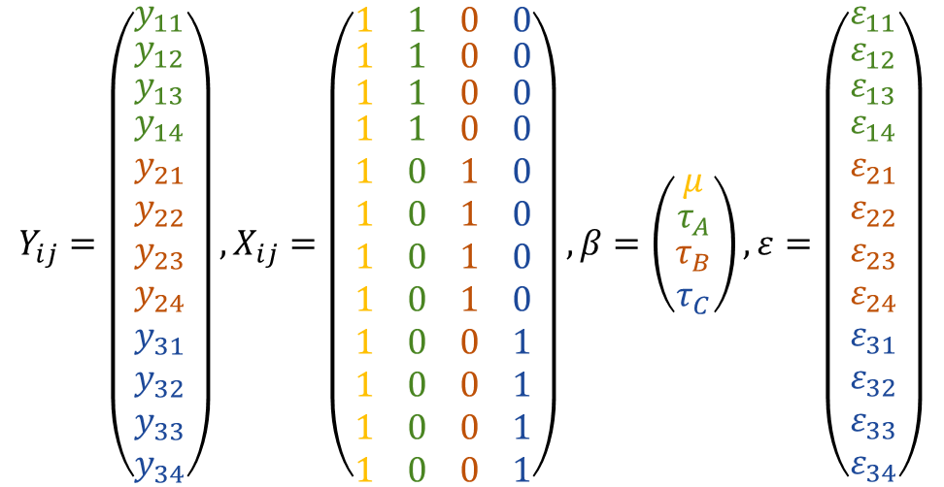

Linear model
$$Y_{ij}=μ+τ_{i}+ε_{ij}$$
$$Y_{ij}=β_{0}X_{μj}+β_{1}X_{Aj}+β_{2}X_{Bj}+β_{3}X_{Cj}+ε_{ij}$$
$β_{0}=$ 𝜇
$$β_{1}={\text{τ}}_{A}$$
$$β_{2}={\text{τ}}_{B}$$
$$β_{3}={\text{τ}}_{C}$$
$$X_{μ}$$
$$X_{A}$$
$$Y_{ij}=\left(\begin{matrix}y_{11} \\ \begin{matrix}y_{12} \\ \begin{matrix}y_{13} \\ \begin{aligned}y_{14} \\ y_{21} \\ y_{22} \\ y_{23} \\ y_{24} \\ y_{31} \\ y_{32} \\ y_{33} \\ y_{34}\end{aligned}\end{matrix}\end{matrix}\end{matrix}\right),X_{ij}=\left(\begin{matrix}1 \\ \begin{matrix}1 \\ \begin{matrix}1 \\ \begin{aligned}1 \\ 1 \\ 1 \\ 1 \\ 1 \\ 1 \\ 1 \\ 1 \\ 1\end{aligned}\end{matrix}\end{matrix}\end{matrix} \begin{matrix}1 \\ \begin{matrix}1 \\ \begin{matrix}1 \\ \begin{aligned}1 \\ 0 \\ 0 \\ 0 \\ 0 \\ 0 \\ 0 \\ 0 \\ 0\end{aligned}\end{matrix}\end{matrix}\end{matrix} \begin{matrix}0 \\ \begin{matrix}0 \\ \begin{matrix}0 \\ \begin{aligned}0 \\ 1 \\ 1 \\ 1 \\ 1 \\ 0 \\ 0 \\ 0 \\ 0\end{aligned}\end{matrix}\end{matrix}\end{matrix} \begin{matrix}0 \\ \begin{matrix}0 \\ \begin{matrix}0 \\ \begin{aligned}0 \\ 0 \\ 0 \\ 0 \\ 0 \\ 1 \\ 1 \\ 1 \\ 1\end{aligned}\end{matrix}\end{matrix}\end{matrix}\right),β=\left(\begin{matrix}μ \\ \begin{matrix}τ_{A} \\ \begin{aligned}τ_{B} \\ τ_{C}\end{aligned}\end{matrix}\end{matrix}\right),ε=\left(\begin{matrix}ε_{11} \\ \begin{matrix}ε_{12} \\ \begin{matrix}ε_{13} \\ \begin{aligned}ε_{14} \\ ε_{21} \\ ε_{22} \\ ε_{23} \\ ε_{24} \\ ε_{31} \\ ε_{32} \\ ε_{33} \\ ε_{34}\end{aligned}\end{matrix}\end{matrix}\end{matrix}\right)$$

Slide 31

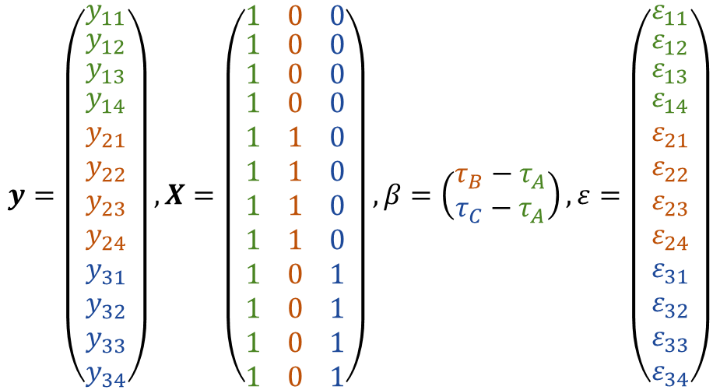



Linear models in R
$$Y_{ij}=μ+τ_{i}+ε_{ij}$$
$$Y_{ij}=β_{1}X_{Aj}+β_{2}X_{Bj}+β_{3}X_{Cj}+ε_{ij}$$
$$Y_{ij}=β_{0}+β_{1}X_{Bj}+β_{2}X_{Cj}+ε_{ij}$$
$$y=\left(\begin{matrix}y_{11} \\ \begin{matrix}y_{12} \\ \begin{matrix}y_{13} \\ \begin{aligned}y_{14} \\ y_{21} \\ y_{22} \\ y_{23} \\ y_{24} \\ y_{31} \\ y_{32} \\ y_{33} \\ y_{34}\end{aligned}\end{matrix}\end{matrix}\end{matrix}\right), X=\left(\begin{matrix}1 \\ \begin{matrix}1 \\ \begin{matrix}1 \\ \begin{aligned}1 \\ 1 \\ 1 \\ 1 \\ 1 \\ 1 \\ 1 \\ 1 \\ 1\end{aligned}\end{matrix}\end{matrix}\end{matrix} \begin{matrix}0 \\ \begin{matrix}0 \\ \begin{matrix}0 \\ \begin{aligned}0 \\ 1 \\ 1 \\ 1 \\ 1 \\ 0 \\ 0 \\ 0 \\ 0\end{aligned}\end{matrix}\end{matrix}\end{matrix} \begin{matrix}0 \\ \begin{matrix}0 \\ \begin{matrix}0 \\ \begin{aligned}0 \\ 0 \\ 0 \\ 0 \\ 0 \\ 1 \\ 1 \\ 1 \\ 1\end{aligned}\end{matrix}\end{matrix}\end{matrix}\right),β=\left(\begin{matrix}τ_{B}−τ_{A} \\ τ_{C}−τ_{A}\end{matrix}\right),ε=\left(\begin{matrix}ε_{11} \\ \begin{matrix}ε_{12} \\ \begin{matrix}ε_{13} \\ \begin{aligned}ε_{14} \\ ε_{21} \\ ε_{22} \\ ε_{23} \\ ε_{24} \\ ε_{31} \\ ε_{32} \\ ε_{33} \\ ε_{34}\end{aligned}\end{matrix}\end{matrix}\end{matrix}\right)$$
$$β_{1}$$
$$2=\left(−2\right)−(−4)$$
$$10=\left(6\right)−(−4)$$
$$β_{2}$$

Slide 32
Linear models in R

Slide 33
Linear model
$$Y_{ij}=β_{0}X_{μj}+β_{1}X_{Aj}+β_{2}X_{Bj}+β_{3}X_{Cj}+ε_{ij}$$
Above ground biomass (g)
40
τ_{C} =6
34
µ
τ_{A} = -4
32
30
τ_{B} = -2
Trt A
Trt B
Trt C

Slide 34
Linear models in R
$$Y_{ij}=β_{0}+β_{1}X_{Bj}+β_{2}X_{Cj}+ε_{ij}$$
Above ground biomass (g)
τ_{C} =6
34
µ
τ_{A} = -4
32
30
τ_{B} = -2
Trt A
Trt B
Trt C

Slide 35
Linear models in R
$$Y_{ij}=β_{0}+β_{2}X_{Bj}+β_{3}X_{Cj}+ε_{ij}$$
$$Y_{Aj}=30+2{(0}_{Bj})+10(0_{Cj})+ε_{ij}$$
$$Y_{Bj}=30+2{(1}_{Bj})+10(0_{Cj})+ε_{ij}$$
Above ground biomass (g)
τ_{C} =6
34
µ
τ_{A} = -4
32
30
τ_{B} = -2
Trt A
Trt B
Trt C

Slide 36
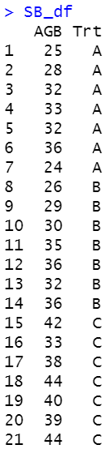
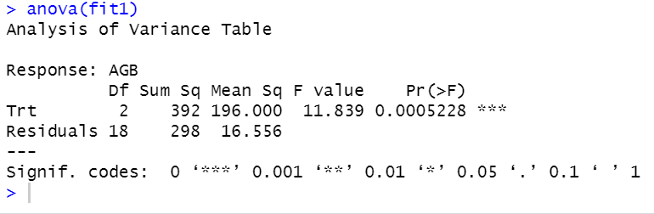
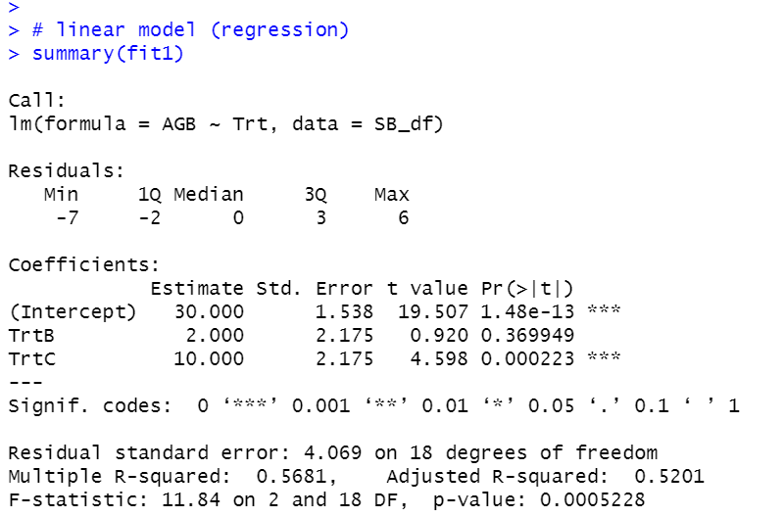
Linear models in R
fit1 <- lm(AGB~Trt, data=SB_df)

